Slide 1



WorldMap and other infrastructures to support geospatial knowledge building
Harvard Datafest
January 23, 2019
Ben Lewis and Devika Kakkar
Harvard Center for Geographic Analysis
Notes:
I’m Ben Lewis with the Harvard center for geographic analysis and today I’m going to talk to you about some simple ways you can use geospatial information within Dataverse by virtue of some integration between Dataverse and a platform called WorldMap that our center manages.

Slide 2
Space Matters to Data (a lot)

Slide 3
Example: 2016 presidential election popular vote
Clinton: 65,853,514
Trump: 62,984,828

Slide 4
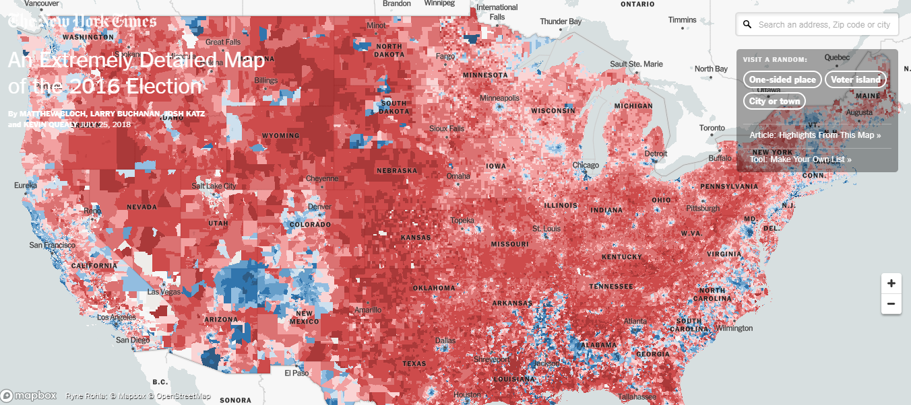
https://www.nytimes.com/interactive/2018/upshot/election-2016-voting-precinct-maps.html

Slide 5
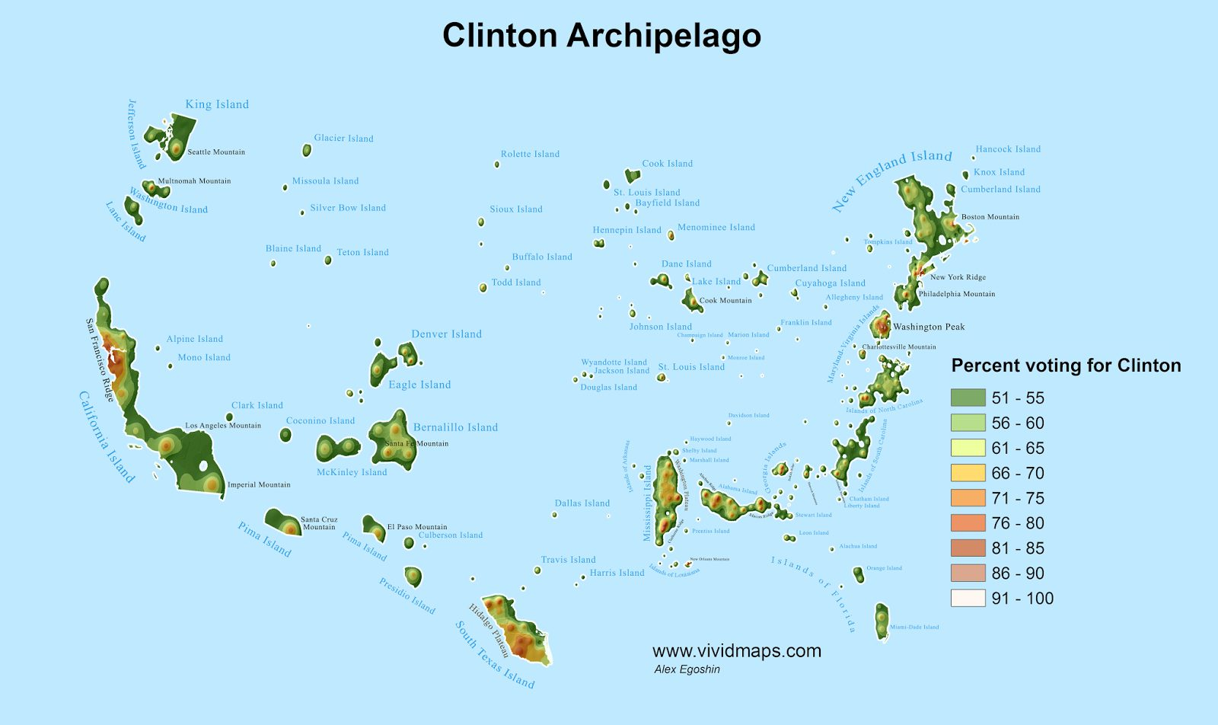

Slide 6
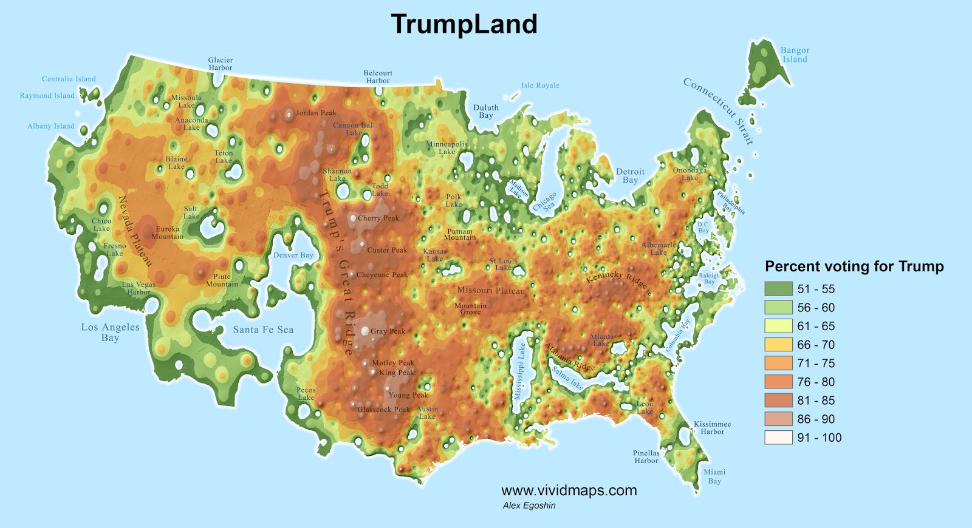

Slide 7



Center for Geographic Analysis (CGA)
Founded in 2006
A member organization of the Institute for Quantitative Social Science (IQSS)
Serves the entire University - all schools and departments

Slide 8

Consulting
Software Development
Teaching

Slide 9
Population we serve
36,000 students.
12,000 professors and academic appointments.
Size of CGA: 4
So we build platforms to leverage ourselves.
https://www.harvard.edu/media-relations/media-resources/quick-facts
Notes:
There are 40 thousand people who could at any time use our services.

Slide 10
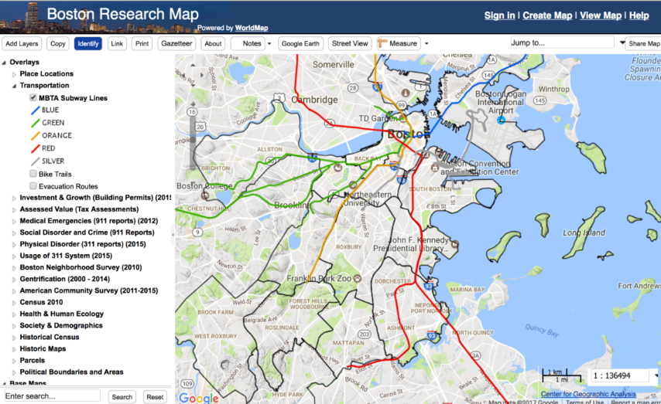



What is WorldMap?
Harvard WorldMap http://worldmap.harvard.edu is an online, open source mapping platform developed to lower barriers for scholars who wish to explore, visualize, edit, and publish geospatial information.

Slide 11
History of WorldMap
Started with AfricaMap in 2008.
WorldMap went online in 2012 as a way to lower barriers for scholars who wanted to visualize their research geographically.
Allows researchers to “scratch their own itch”, and make custom maps for their own purposes.

Slide 12
Growth of the System
Within a year 10,000 users had signed up and 10,000 layers contributed.
Growth created challenges, particularly for data search and discovery.
This lead to the development of Hhypermap to improve search

Slide 13
WorldMap enables researchers to
Upload raster and vector geodata and view it online
Create and edit geodata online
Create data-driven geospatial visualizations
Export geodata to a variety of formats
Create maps services for any layer for visualization in other systems
Share map compositions with small or large groups
Control access to their data

Slide 14
The best geodata is outside any single organization
National Governments
NGOs
Local Governments
Civil Society
Business
Universities

Slide 15
Connects to many types of data source
Open Street Maps, Stamen Design
Google Street View
Geonames, Nominatum, Google Places
WMS
ESRI REST
Shape files
GeoTIFF files
GeoJSON (new version)

Slide 16
Web Map API: Map Services for visualizing your data in other systems
Visualize map layers you create in any other standards-based system without data transfer by accessing WorldMap’s web map API for individual layers or collections of layers.
First add your layer to a Map and save it.
Get the ID number for your Map from the Share Map link on the map. The number in the URL is the ID.
Use the format below to create a WMS URL that can be used to remotely access the layers in any map or the layers owned by any user. http://worldmap.harvard.edu/capabilities/map/<map_id_num>
http://worldmap.harvard.edu/capabilities/user/<username>
Examples:
http://worldmap.harvard.edu/capabilities/map/79/ (ChinaMap) http://worldmap.harvard.edu/capabilities/user/blewis (Layers owned by Ben Lewis)

Slide 17
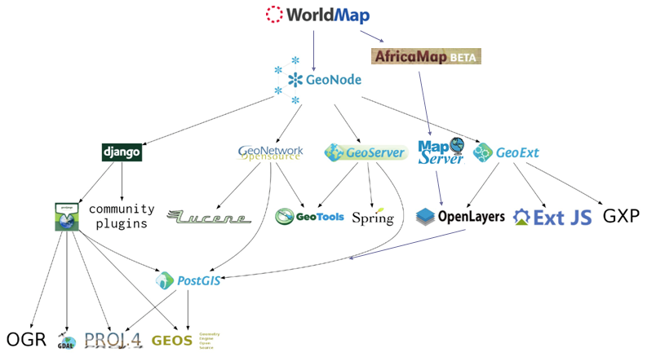
Open Source Code https://github.com/cga-harvard/geonode/tree/master

Slide 18
PostGIS: a geodata analytics DB that scales
The geospatially enabled database, PostGIS (postgres + geospatial libraries) can perform variety of geo processing tasks at scale.
CGA recently completed work for professor Ryan Enos requiring 300 billion distance calculations.
With some tricks we generated 20,000 distance calculations / second on a dataset of 200 million records.
Some of the powerful geospatial PostGIS functions: geohash, nearest, within, buffering, etc.
PL/R enables users to write user-defined SQL functions in R using PostGIS
Notes:
PL/R is a loadable procedural language that enables a user to write user-defined SQL functions in the R programming language

Slide 19
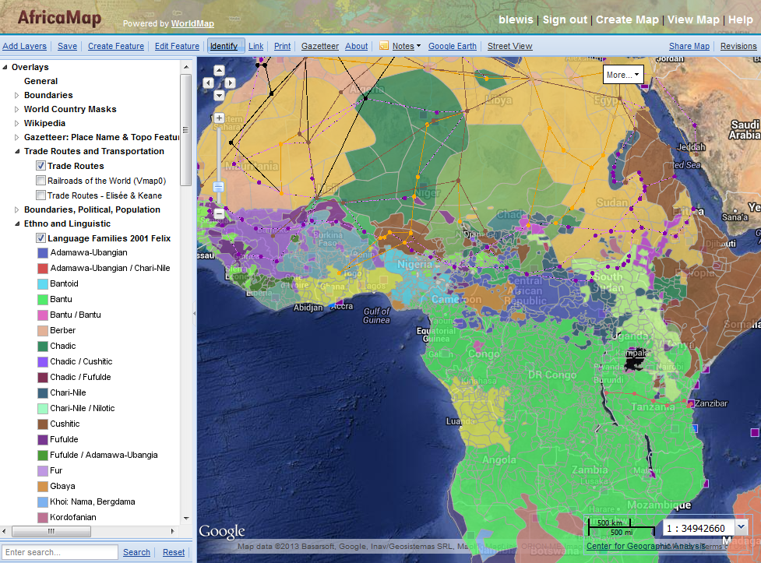
AfricaMap
Faculty: Suzanne Blier, Art History
http://worldmap.harvard.edu/africamap
Notes:
AfricaMap developed by Suzanne Blier brings together a vast amount of mapping data on Africa.

Slide 20
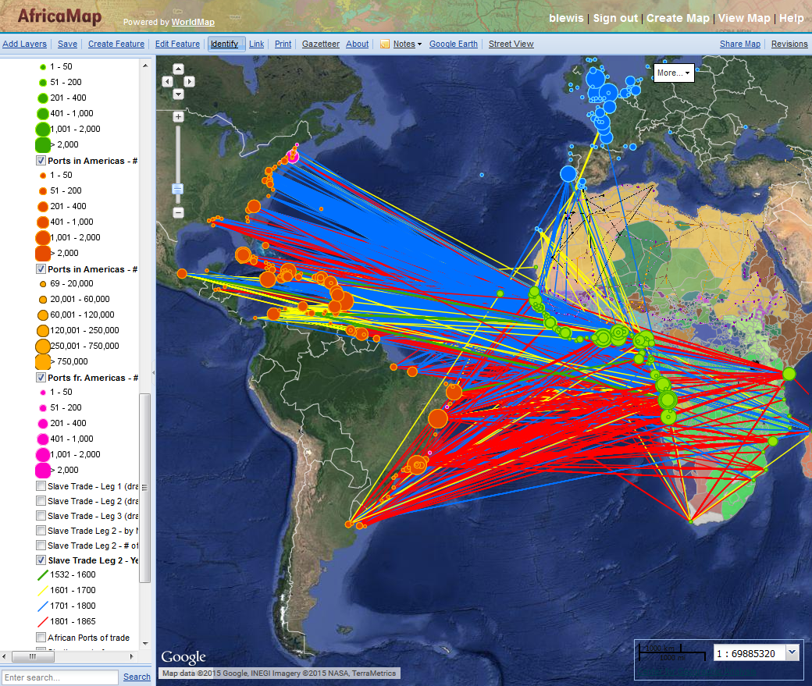
Georeferencing the Trans-Atlantic Slave Trade Database
Faculty: Henry Louis Gates Jr., English and Suzanne Blier, Art History
http://www.slavevoyages.org
http://worldmap.harvard.edu/maps/africamap/PGo
Notes:
Ben: Georeferenced most of the 35,000 records in the transatlantic slave trade database maintained at Emory.
Faculty: Henry Louis Gates, Suzanne Blier
http://www.slavevoyages.org
http://worldmap.harvard.edu/maps/africamap/PGo

Slide 21
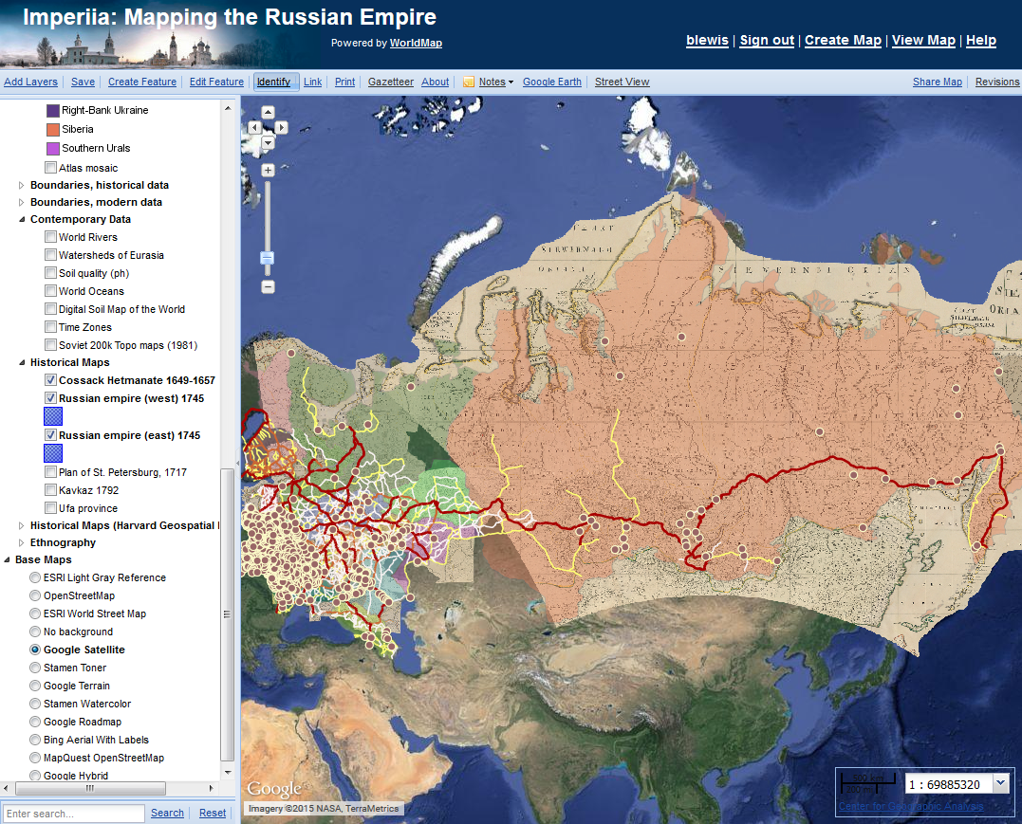
Mapping the Russian Empire
Faculty: Kelly O’Neill, History
http://worldmap.harvard.edu/maps/russianempire
Notes:
Managed large historic Atlas georeferencing project to create base data.
Helped with loading data to WorldMap, training, support.
Faculty: Kelly O’Neil
http://worldmap.harvard.edu/maps/russianempire

Slide 22
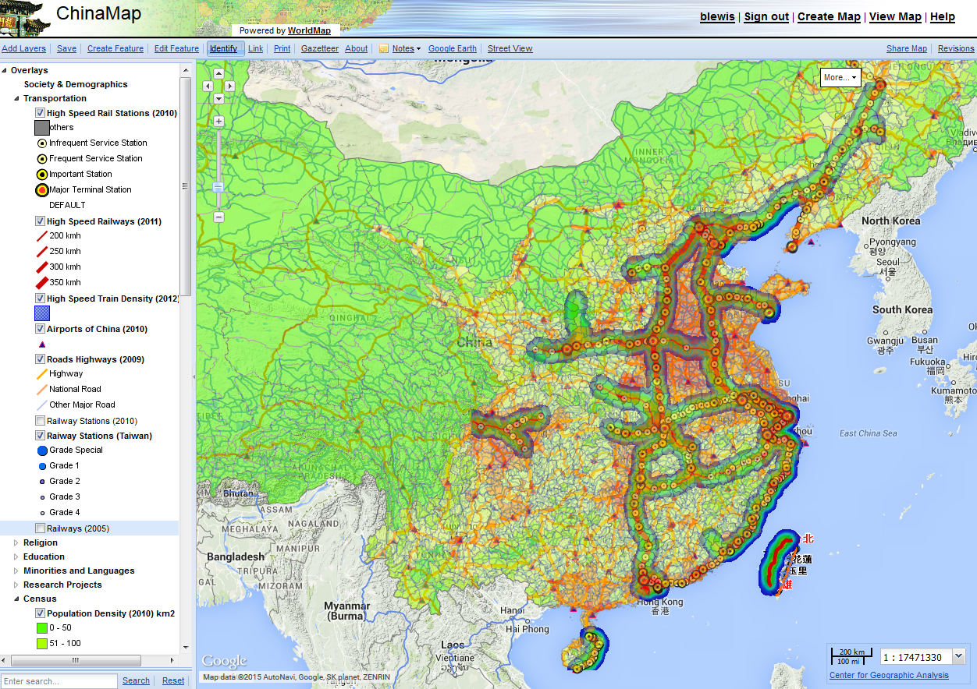
Mapping Contemporary China
Faculty: Peter Bol, Chinese History
http://worldmap.harvard.edu/chinamap
Notes:
http://worldmap.harvard.edu/chinamap

Slide 23
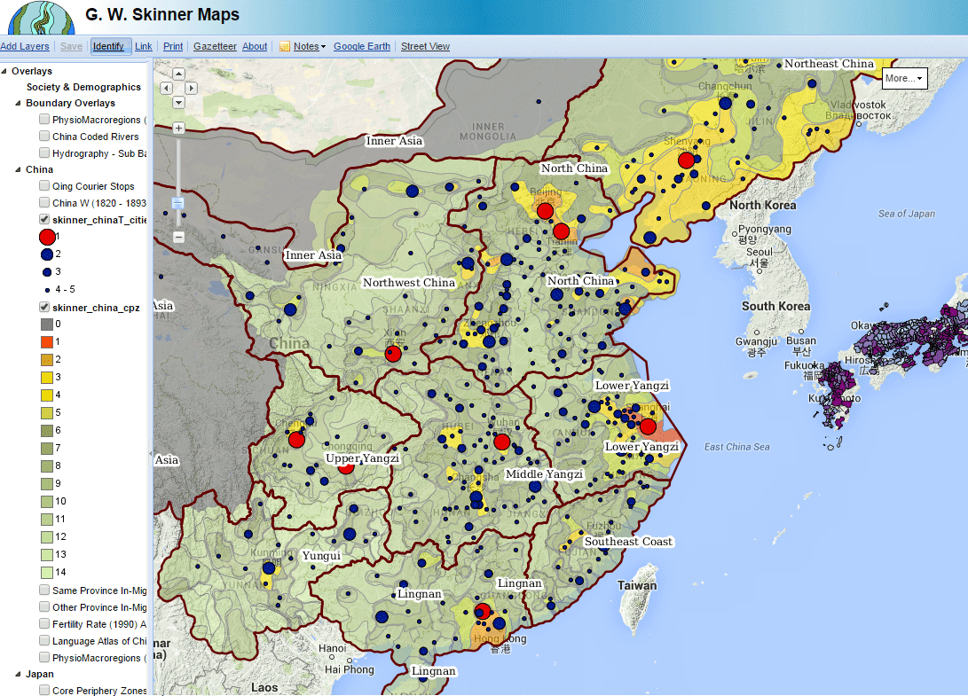
Regional Systems Analysis for China and Japan
Faculty: Peter Bol, EALC
http://worldmap.harvard.edu/maps/skinner
Notes:
Lex: The Regional Systems Analysis Project, directed by the late G. W. Skinner, is based on a series of statistical and geographic processes to reveal the core and periphery zones of social and economic systems. The G. W. Skinner estate bequested the data from his lab (formerly at UC Davis) to Harvard, and the data has been processed by CGA for archiving using the DataVerse Repository. Representative maps from the analysis are also hosted on CGA’s WorldMap platform.

Slide 24
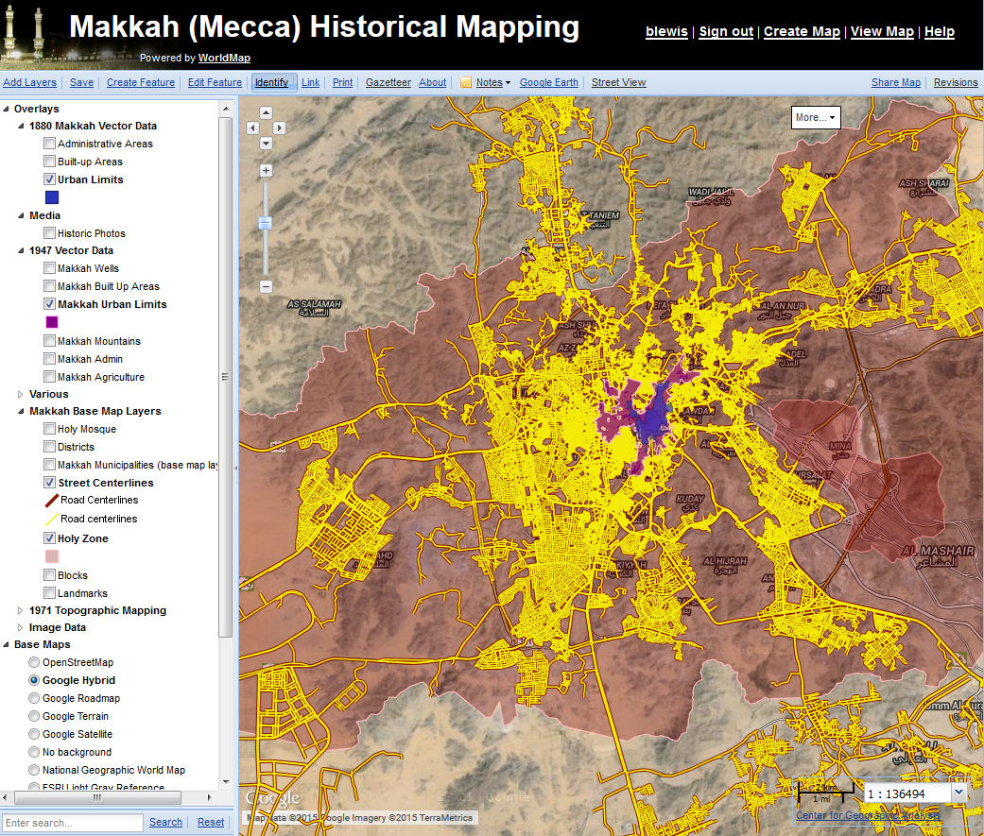
Mapping Historical Makkah
Faculty: Meraj Mirza (Umm Al-Qura University)
and CGA Fellow
http://worldmap.harvard.edu/makkahhistorical/
Notes:
Example of one of the scholars outside Harvard we have collaborated with because of WorldMap.
Helped gather and organize a large amount of spatial data for Makkah, Saudi Arabia
Professor Meraj Mirza, Umm Al-Qura University
http://worldmap.harvard.edu/makkahhistorical/
http://uqu.edu.sa/english

Slide 25
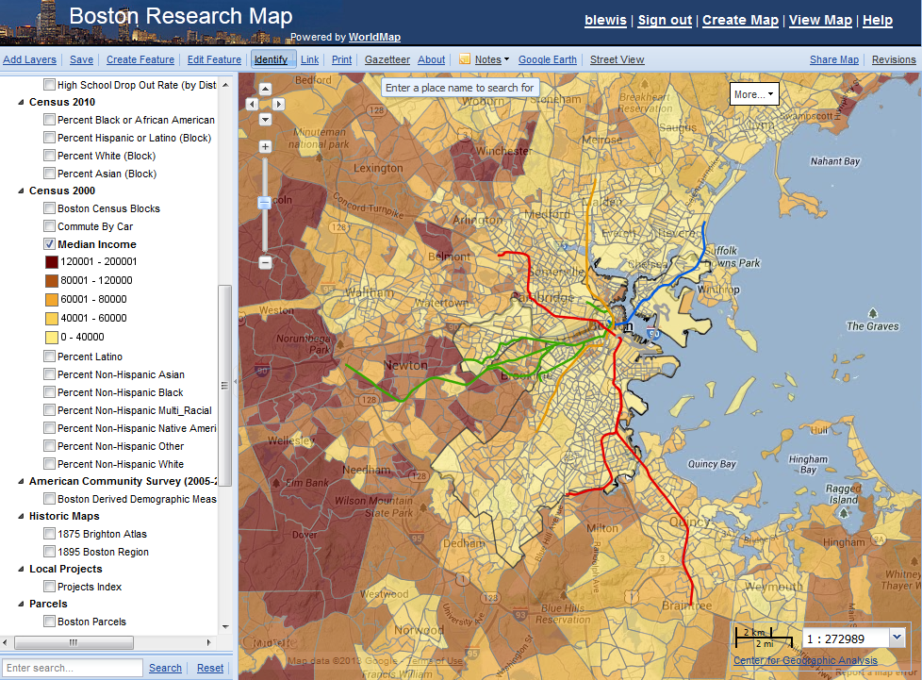
Boston Research Map
Faculty: Chris Winship (Sociology) and Kennedy School, Radcliffe, Boston Area Research Initiative.
To bridge the town/gown divide and facilitate data sharing between the city of Boston which creates data and Harvard scholars who make sense of it.
Three major phases of software and data development over 4 years.
http://worldmap.harvard.edu/boston/
Notes:
Chris Winship, Sociology et. al.
Radcliffe, Kennedy School,
Boston Area Research Initiative
4 major phases of data and software development
Chris Winship, David Luberoff, Dan O’Brien, Radcliffe, Boston Area Research Initiative
http://worldmap.harvard.edu/boston/

Slide 26
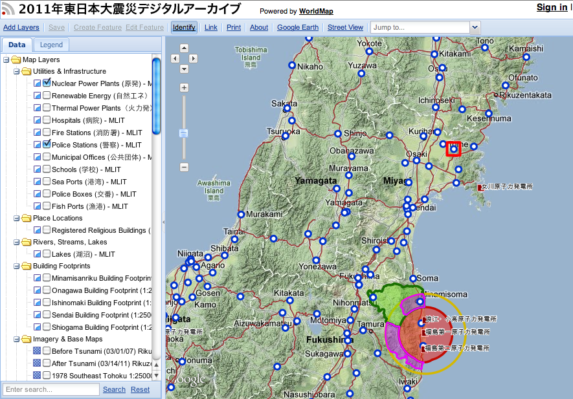
Geographic Resources for the Sendai Earthquake
Faculty: Andrew Gordon, History
https://worldmap.harvard.edu/japanmap/
http://jdarchive.org
Notes:
Lex: In partnership with the Daishinsai Archive, directed by Prof. Andrew Gordon (Reischauer Center for Japanese Studies), CGA developed a large archive of geographic data resources and made them publicly available using the WorldMap plaftorm. These data layers include various types of information, including radiation levels, evacuation zones, tsunami inundation models, building damage assessments, and casualty counts. In addition, CGA obtained permission to distribute a large archive of basic geographic information, including locations of schools, police boxes, hospitals, etc. This data collection is a major resource for the study of modern Japan as well as the earthquake’s impact on Japanese society.
Ben: In addition the CGA developed a high speed mapping solution for the Japan Data Archive http://jdarchive.org which contains millions of objects that need to be displayed on a map in response to interactive queries.

Slide 27
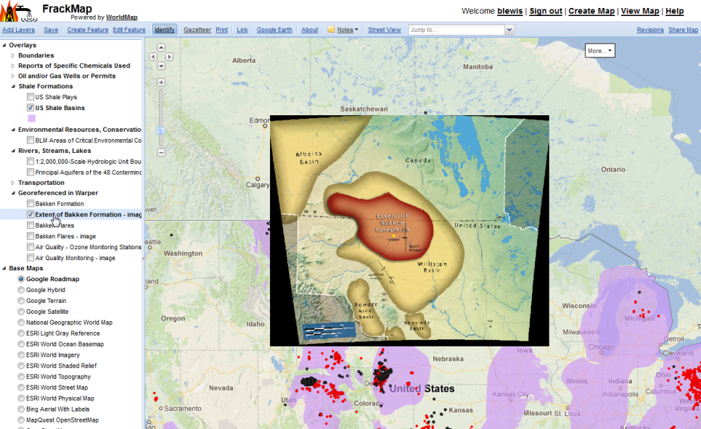
Mapping Fracking
Sponsor: Ann Backus, Harvard School of Public Health
http://worldmap.harvard.edu/maps/FrackMap
Notes:
Here is data brought together from various sources around the topic of fracking.
This is a map of the bakken shale, one of the best places in the U.S. to Frack.
Developed in a collaboration with Harvard School of Public Health
For Anne Backus, Director of Outreach Program, HSPH

Slide 28
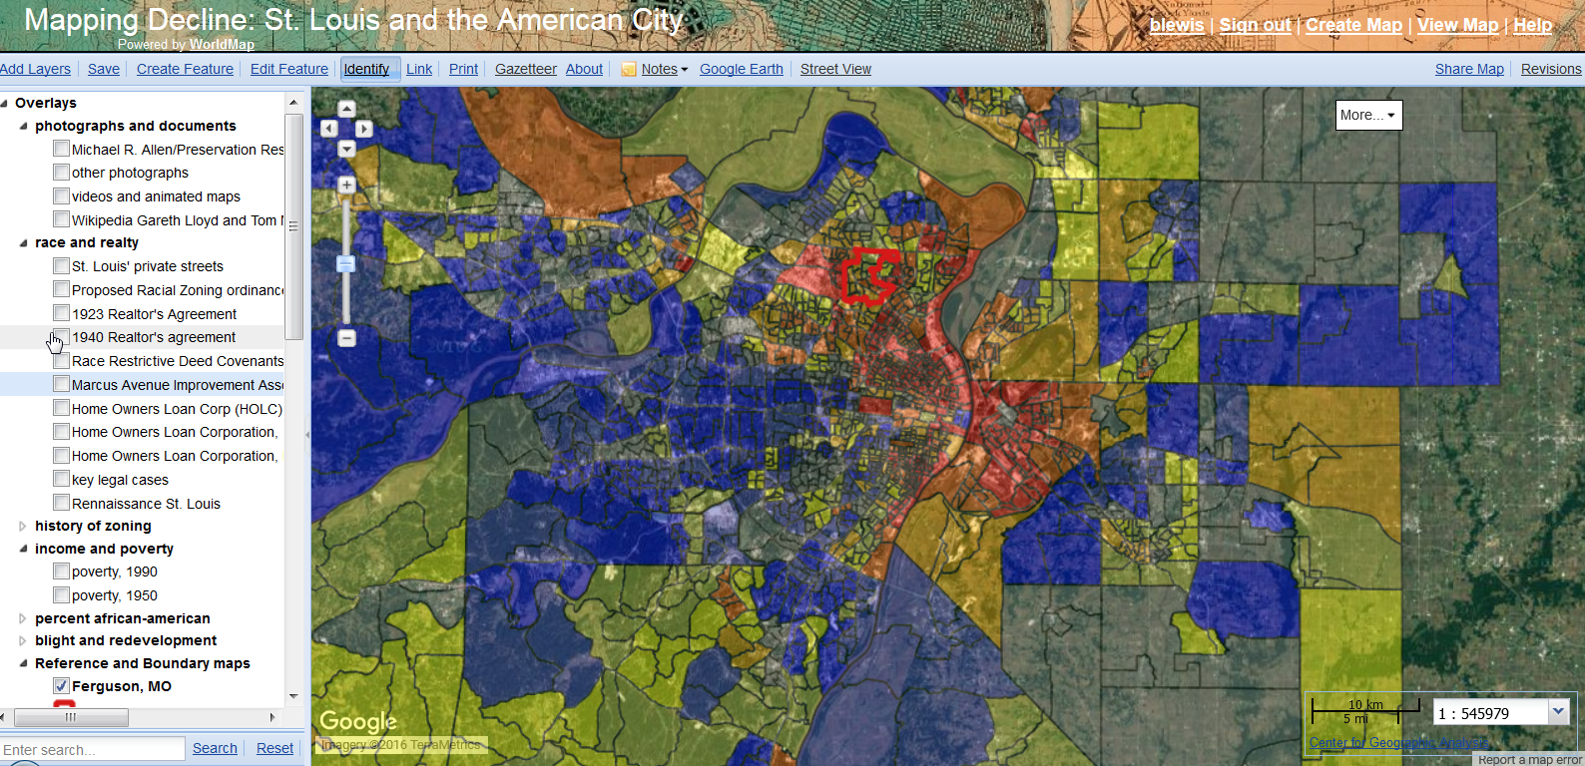
Mapping Decline: St. Louis and the American City (University of Iowa)
Notes:
Colin Gordon Univ Iowa

Slide 29
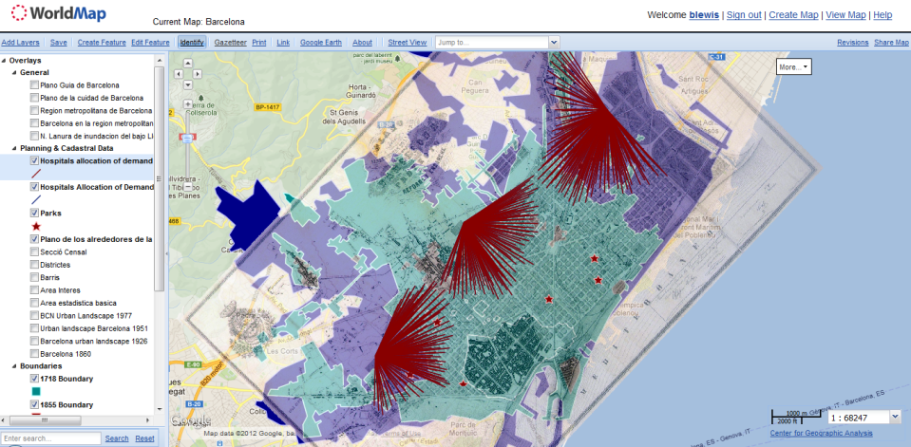
Barcelona Historic Plan (Universitat Autonoma de Barcelona)

Slide 30
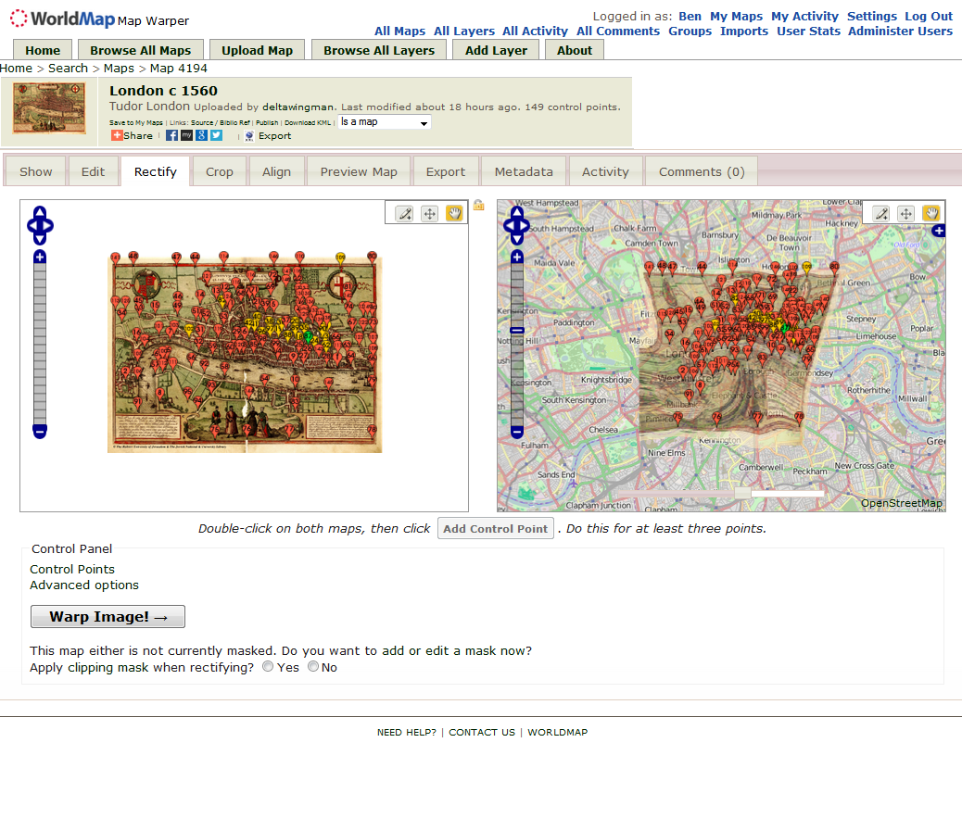
An Online Georeferencing Platform
Supports multiple professors and students
http://warp.worldmap.harvard.edu/
Notes:
Ben: Installed, configured, maintaining NYPL’s open source Warper platform on Amazon as a cloud service.
Supports many professors and students.
~1100 Registered Users
~3000 Georeferenced Images
http://warp.worldmap.harvard.edu/

Slide 31

HarvardX and ChinaX

Slide 32
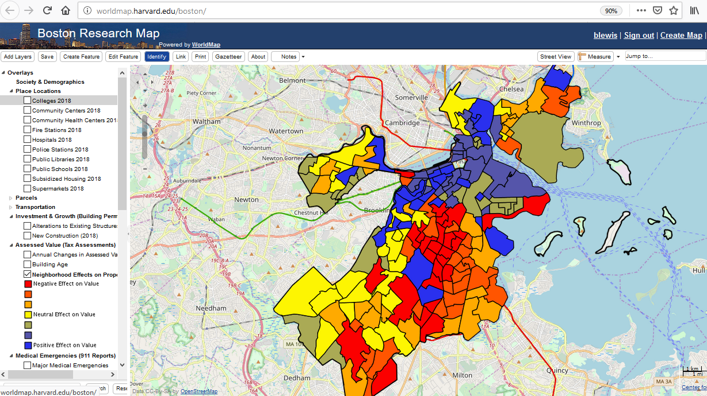
BARI (Boston Area Research Initiative)

Slide 33
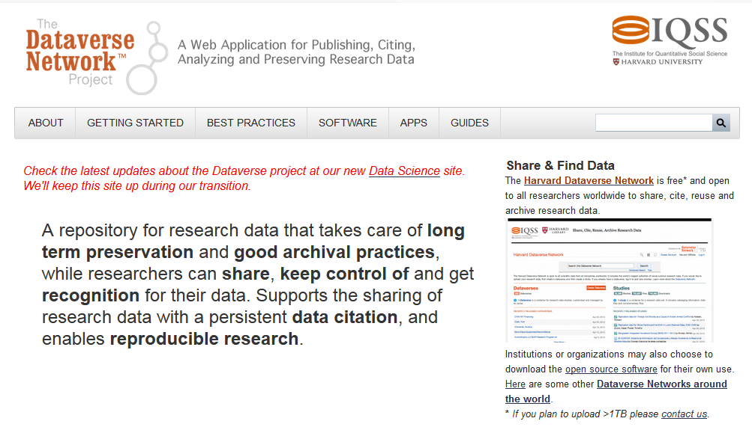
Dataverse Platform (Social Science Archive)

Slide 34
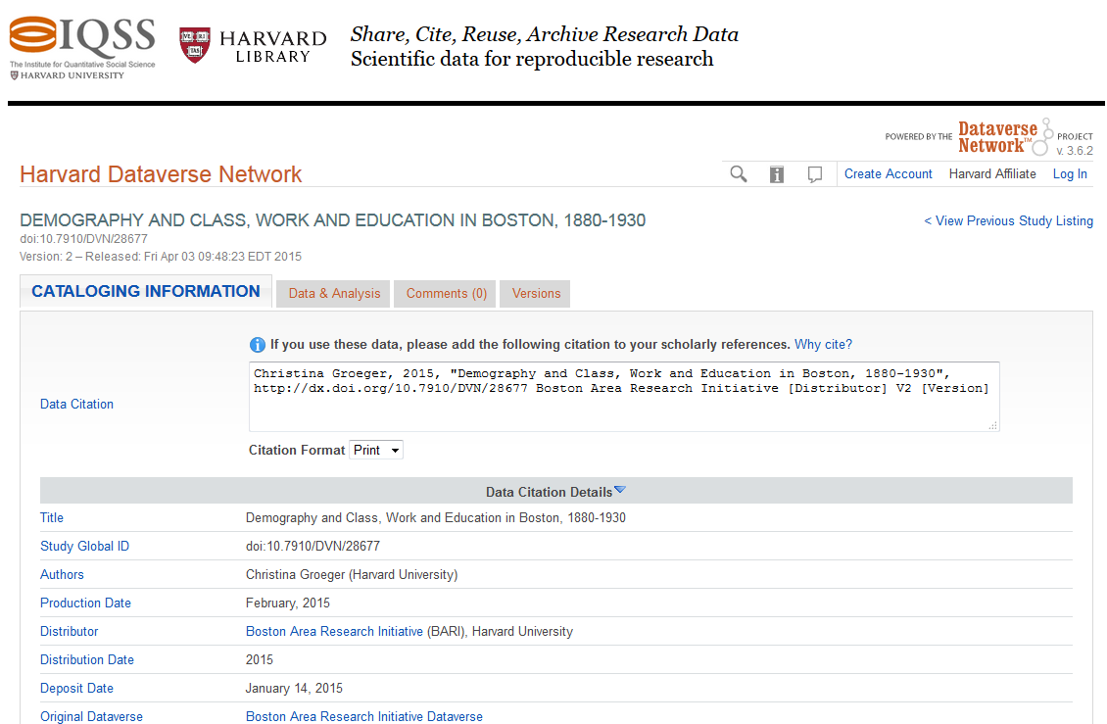


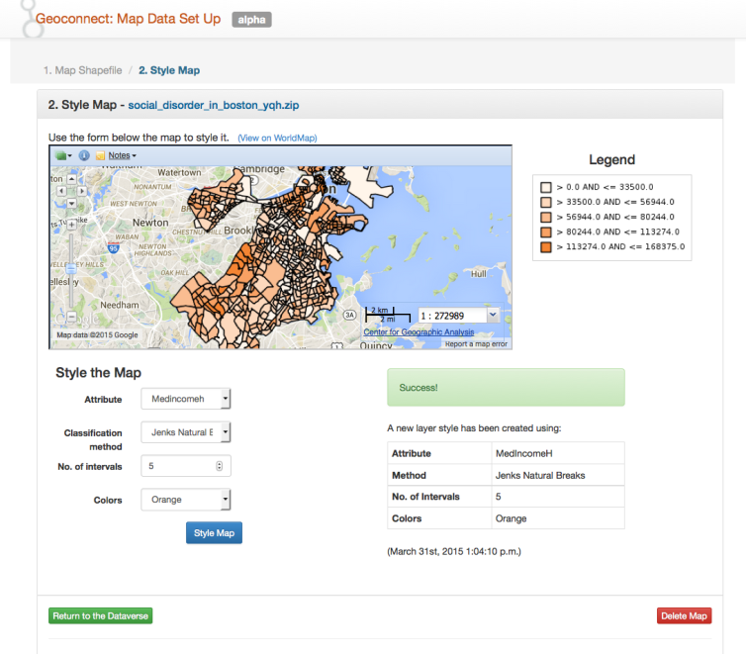
Dataverse <–> WorldMap Integration via Table Geocoding
Table Geocoding Service
Dataverse is industrial-strength archive for social science data.
WorldMap is scalable geovisualization platform.
Connect them to let researchers visualize their data spatially without leaving the comfort of their social science platform.
Faculty: Robert Sampson (Sociology) and others
http://datascience.iq.harvard.edu/blog/bari-project-integrating-dataverse-worldmap
Notes:
Working with Boston Area Research Initiative, and Dataverse team, developed a data table geocoding capability for Dataverse.
Faculty: Robert Sampson, Chris Winship, Gary King
URL: system to be released May 2015.

Slide 35
Demo of basic WorldMap functions
Creating a map
Searching for data
Adding a layer
Styling a layer
Sharing a layer
Sharing a map
Saving a map

Slide 36
WorldMap Sustainability
The WorldMap project is 10 years old and facing challenges on sustainability.
We are actively working on a long-term solution for the platform and content.
Users may experience some changes in the next 6 to 12 months.
We will do our best to keep everyone posted as we know more and maintain continuity.

Slide 37
A couple other initiatives…

Slide 38

“Big” geospatial data: even a million features
Most sets of geographic features are modest: thousands to millions in size. But...
Increasing spatial resolution is changing this: e.g. National Hydro Datasets Medium Res -> ~3M reaches, High Res -> ~30M reaches. Similar for gridded data, e.g. 10m DEM -> 1m Lidar-based 3DEP increases volume 100x.
Time is changing this: multiple observations and predictions for multiple feature properties quickly combine into billions of records.
Traditional GIS software struggles to access and visualize, let alone analyze such scales and structures of datasets.
Datasets with 1-100 billion records are becoming common in academic, business, and government domains
Notes:
Most of Gis data is thousands to millions
Increasing spatial resolution is changing this
Time is changing this: Multiple observation and predctions for multiple features properties quickly combine into billions of records
Traditional GIS software struggles to access and visualize let alone analyze
Dataset with 1-1000 billion records are becoming common in academics

Slide 39
Harvesting geo-tweets from 2012 to present
The CGA has been running a geo-tweet harvester since October 2012
About 1% of tweets contain GPS coordinates from the originating device or ~400,000 per day
Total tweets harvested: about 8 billion

Slide 40
What is a geo-tweet?
A tweet that when harvested via the twitter API, contains a latitude/longitude coordinate describing the place it was tweeted from as provided by the GPS receiver on board the device used to write the tweet.
All tweets also have a time stamp so geo-tweets represent a unique form of public record which is spatio-temporal in nature.
For all utterances one knows the precise time, location, user name, and language.
To request geo-tweets:
https://dataverse.harvard.edu/dataset.xhtml?persistentId=doi:10.7910/DVN/3NCMB6

Slide 41
OmniSci / Harvard Collaboration
OmniSci is GPU-powered database, a column-oriented data store that supports a subset of SQL as well as Vega visualization grammar.
Begun at Harvard CGA in 2012 when Middle Eastern Studies student Todd Mostak and CGA analyst Ben Lewis began considering the benefits of a GPU-powered database for exploring hundreds of millions of tweets in WorldMap (“TweetMap”).
Todd then worked with Sam Madden at MIT and founded OmniSci (previously MapD) to develop a commercial-scale GPU-powered data exploration platform.
To accelerate adoption by the broader geospatial and data science community, OmniSci open-sourced its core database and chart rendering engine on Github with render free for academic use.
OmniSci entered into a collaboration with CGA to explore research use cases, starting with experiments to analyze output from the National Water Model.

Slide 42
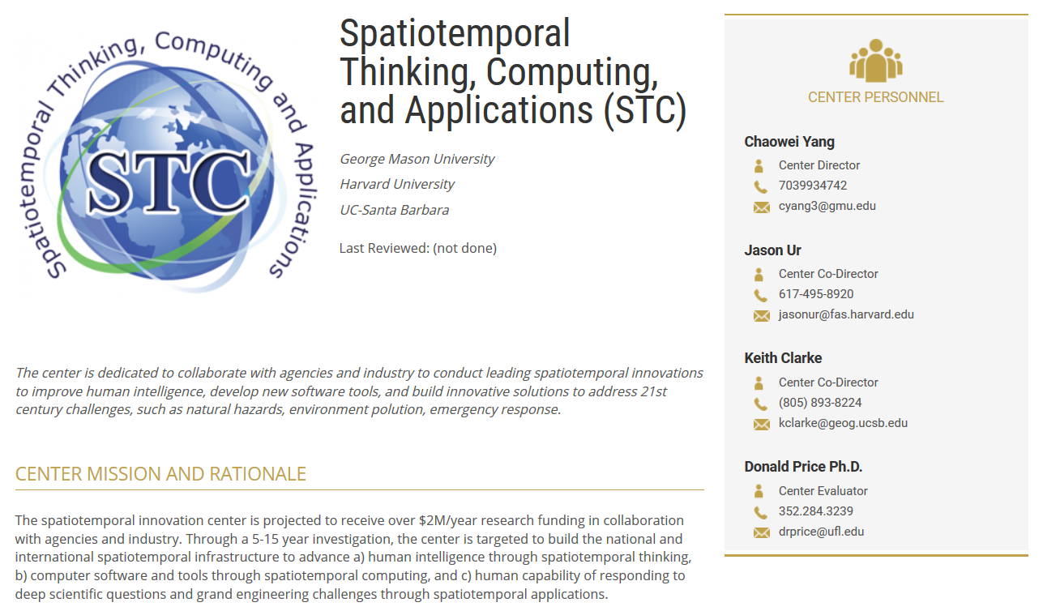
I/UCRC Spatio-temporal Consortium
George Mason University
University of California Santa Barbara
Harvard University

Slide 43
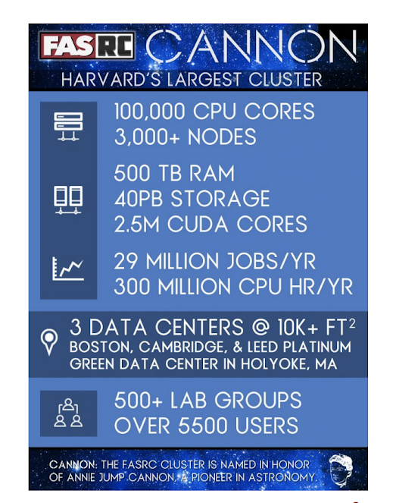
Supercomputing Environment: Cannon Cluster
Compute: 100,000 compute nodes, 8-64 cores/node, 12Gb to 512Gb memory/node, 2,500,000 NVIDIA GPU cores
Software: CentOS 7 operating system, Slurm job manager, Singularity, 1000+ scientific tools and programs
Storage: 100 GB (Home dir), 4TB+ (Lab storage), 70Gb/node (Local scratch), 2.4PB (Global scratch), 3PB (Persistent Research data)
#144 in TOP500 Supercomputers in world

Slide 44
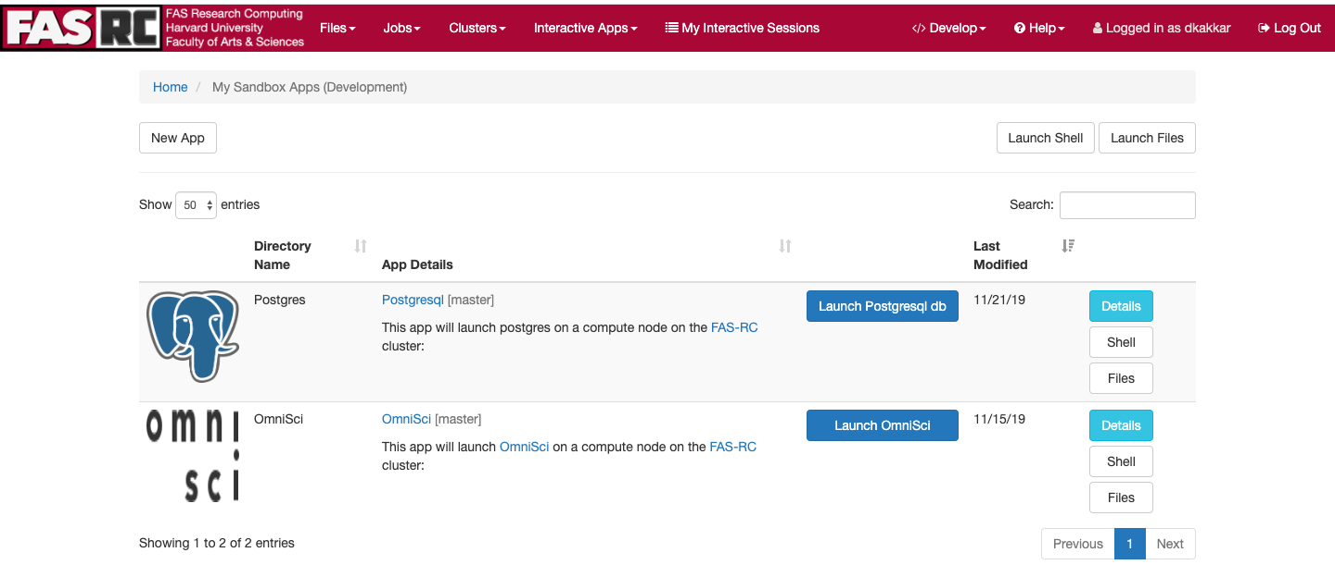
GIS apps that we are currently configuring on FASRC

Slide 45
Links
Harvard WorldMap
https://en.wikipedia.org/wiki/WorldMap
ChinaX
https://www.edx.org/chinax-chinas-past-present-future
Map Warper
http://mapwarper.net
HHypermap (Harvard Hypermap)
https://link.springer.com/article/10.1186/s40965-018-0051-x
Geo-tweet Archive
https://dataverse.harvard.edu/dataset.xhtml?persistentId=doi:10.7910/DVN/3NCMB6
Harvard Cannon Cluster
https://www.rc.fas.harvard.edu/about/cluster-architecture/
OmniSci GPU Database
https://github.com/omnisci/omniscidb
PostGIS
https://postgis.net/
ArcGIS Enterprise
https://enterprise.arcgis.com/en/

Slide 46
Thank you
Ben Lewis
blewis@cga.harvard.edu

Slide 47
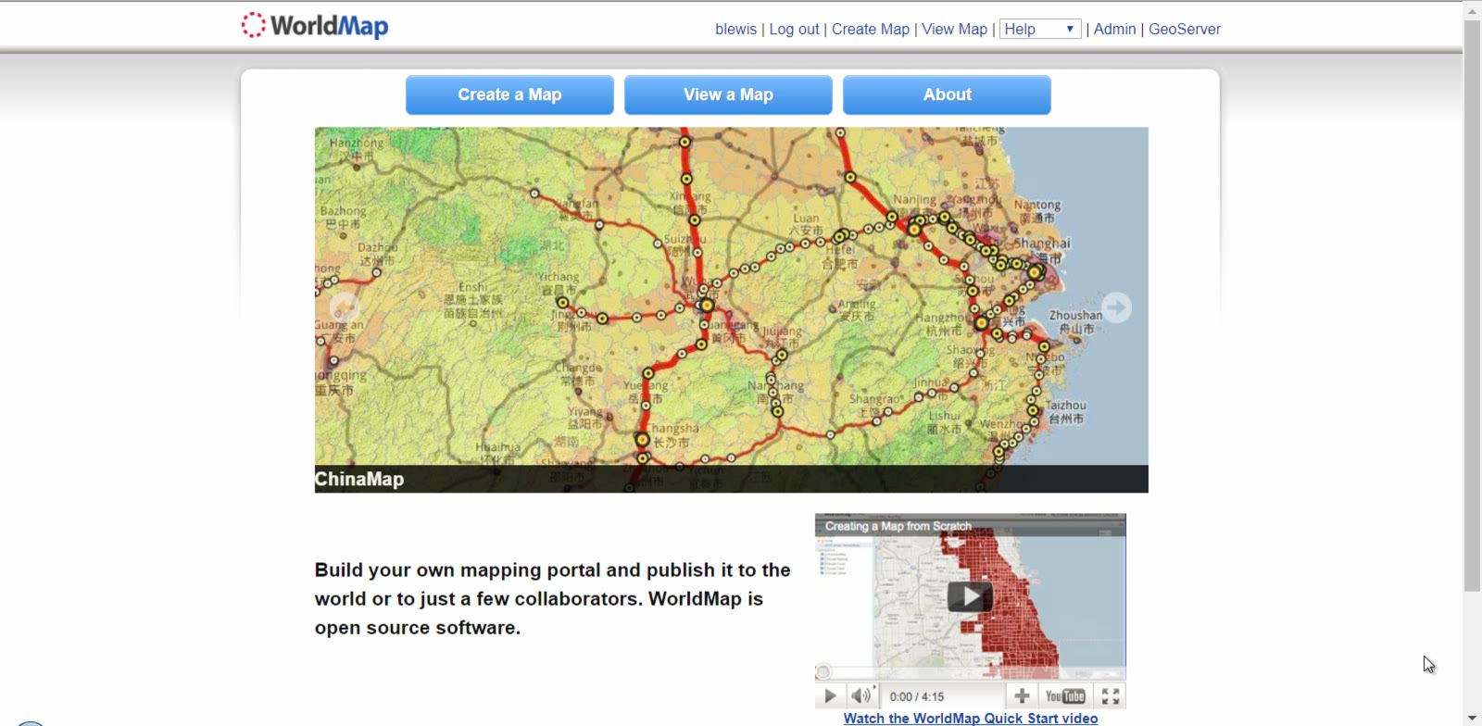
Search Demo
Notes:
1:40

Slide 48
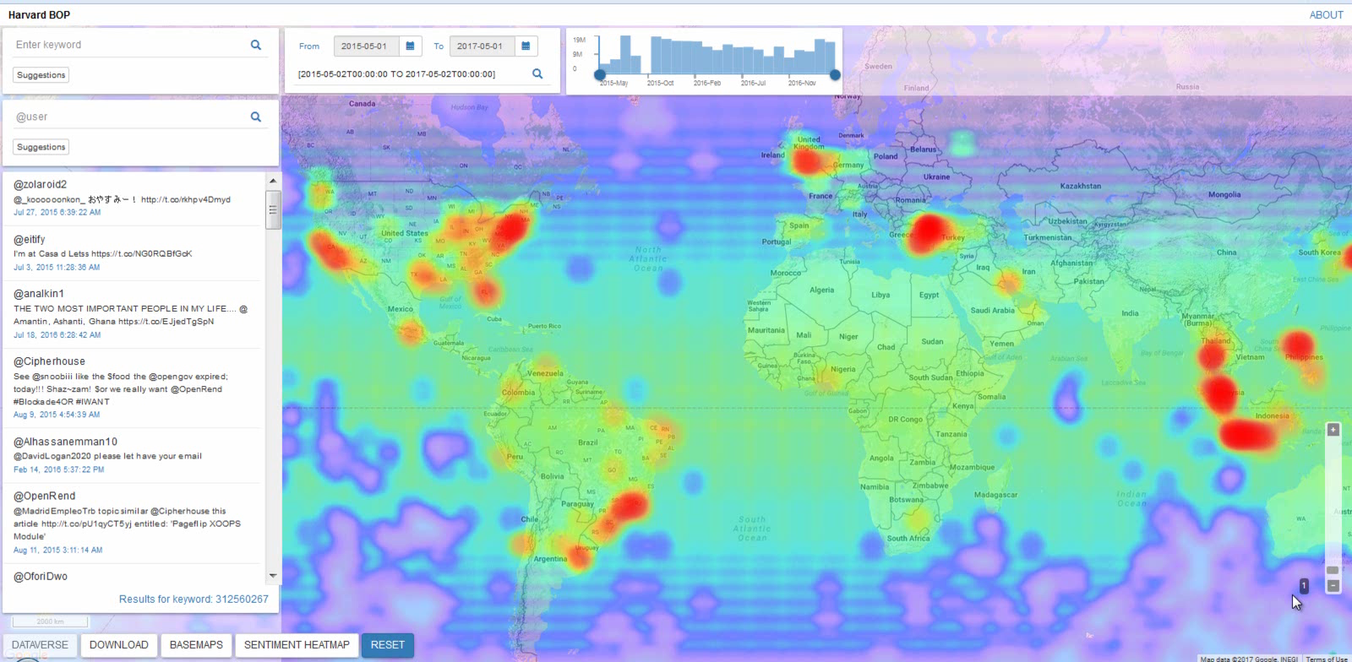
BOP Demo
Notes:
2:10

Slide 49
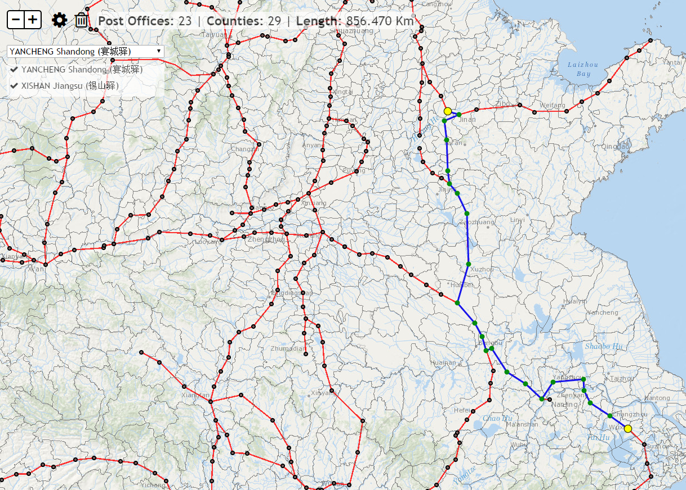
Chinese Late Ming Dynasty Courier Route
Faculty: Peter Bol, History
http://cga-3.hmdc.harvard.edu/chinapostoffice/
Notes:
Giovanni: The Chinese Late Ming Dynasty Courier Route System application calculates the total distance between postal stations, the number of postal stations visited, and the number of counties (circa 1911) that were crossed. You can select postal stations from the pull-down menu or pick them by clicking on the map. Click the gear icon to calculate a new route and the trash icon to clear an existing route. More data info at:http://worldmap.harvard.edu/maps/china-history/Kkj

Slide 50
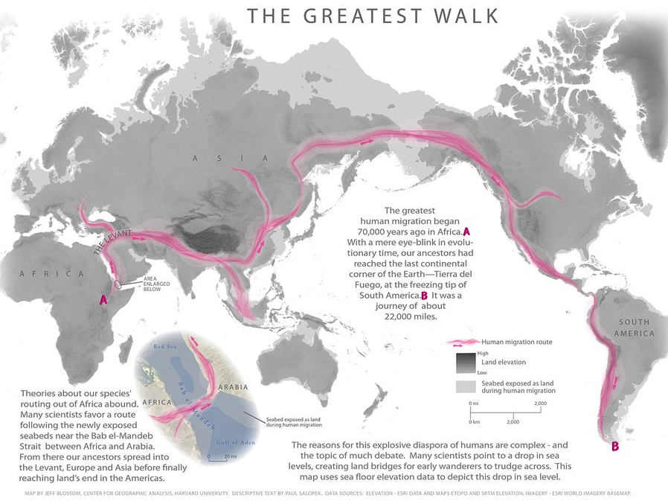
Out of Eden Walk Mapping Support
Provided for Paul Salopek, Nieman Fellow for Journalism
http://www.outofedenwalk.com/map-room/thematic-maps/
Notes:
Jeff: Map creation and GIS support for The Out of Eden Walk project – a 7 year global walk following the path of human migration focusing on human themes using “slow journalism” reportage.

Slide 51
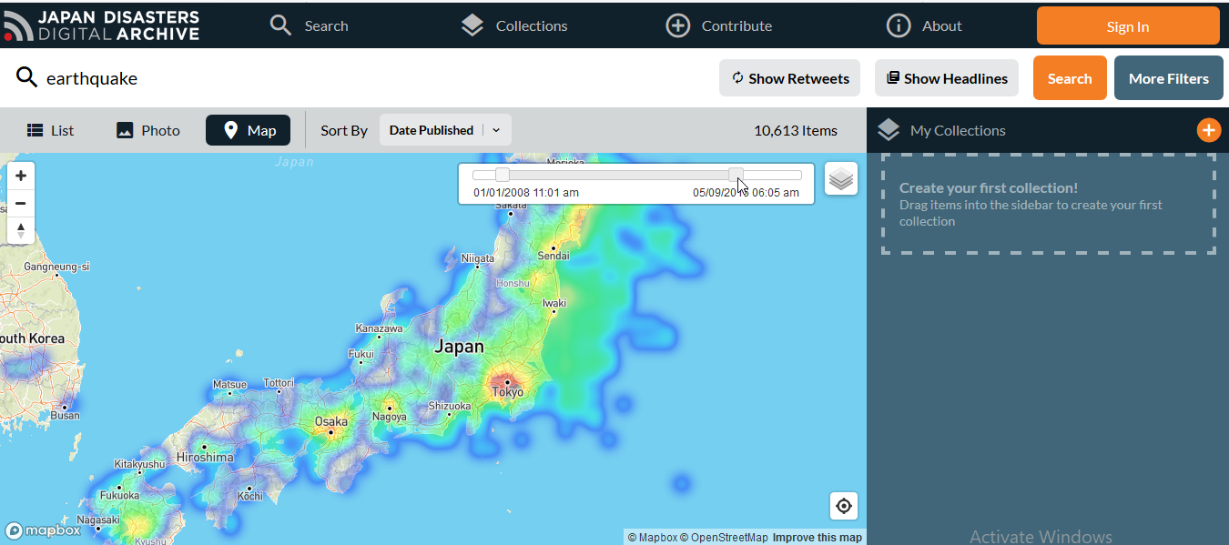
Japan Data Archive & High Speed Mapping Platform
Faculty: Andrew Gordon, History
http://jdarchive.org
Notes:
Ben: Developed special high speed, GPU-powered mapping engine (GEOPS) to support visualization of the large Reischauer Institute Japan Earthquake Digital Archive
Faculty: Andrew Gordon, FAS History
http://jdarchive.org

Slide 52
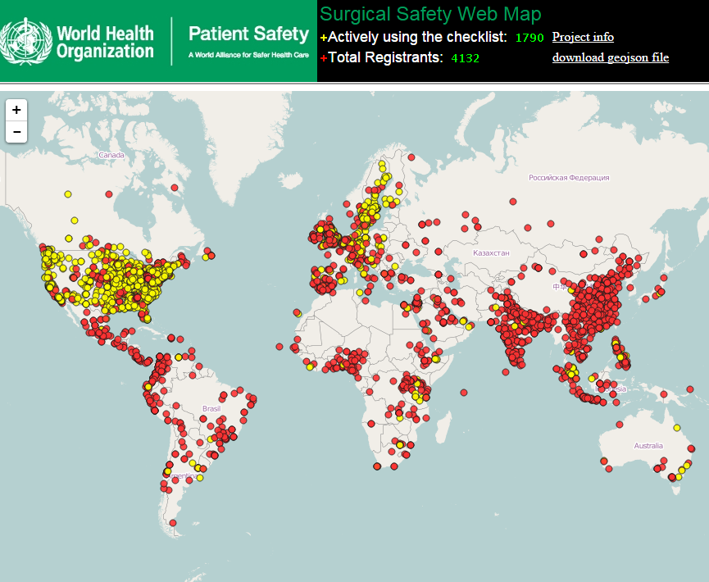
Surgical Safety Web Map
Faculty: Atul Gawande, HSPH
http://bit.ly/1GksOKu
Notes:
A web map was created to aid the dissemination of the Surgical Safety Checklist. The Surgical Safety team used the map to display participating hospital locations, and upload new hospital information and locations.

Slide 53
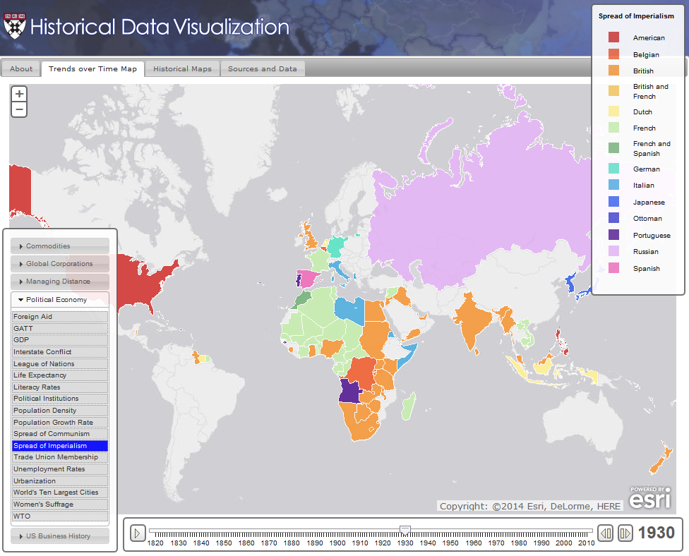
Historical Data Visualization (HDV)
Faculty: Geoffrey Jones (HBS)
http://hdv.cga.harvard.edu/
Notes:
Giovanni and Ben: The Historical Data Visualization tool (HDV), was created to support the Harvard Business History Initiative to better understand spatial patterns in global capitalism. The tool provides data on a range of U.S. and global economic, social, and political trends. The project was driven by professor Geoffrey Jones and evolved in three major phases over four years.

